Slide 1
Sourcing: Reporting and SDI (Sourcing Desktop Intelligence)
August, 2013

Slide 2
Agenda
In this presentation and hands-on we will:
  Discuss the Reporting capabilities in Sourcing, focusing on Sourcing Desktop Intelligence (SDI)
  Cover the steps in creating some of the reports
Note: SDI continues to evolve. There were many improvements added in V10.0.1, including selection of Lots and Items for a report, field totals, ordering of fields, and support for 64-bit Excel.

Slide 3
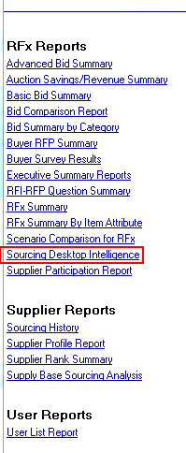
Accessing and Generating Reports
Sourcing provides a large number of reports OOTB
The reports that are pertinent to the RFx that is being viewed are accessible through its Description area
The entire set of reports can be found via Utilities > Reports > Standard Reports, which opens the Executive Dashboard. The menu on the left side of that is shown here ==>
Here our focus is on reports that can be obtained through Sourcing Desktop Intelligence (SDI):
    Standard Quantitative Reports: These let you study and compare the bids through a variety of presentations, with filtering by Lot, Supplier, or Item.
    Advanced Quantitative Reports: Similar to the basic reports but with more customization capability
    Qualitative Report: This lets you get an Excel or Word report on the questionnaire responses.

Slide 4
Report Features
There are two phases to SDI: (1) Generate the Excel file that includes all of the event information needed for potential reports; (2) Create the reports using the Excel add-in; this step does not require access to Sourcing.
Advanced Quantitative Report:
    Choose which Item Fields (Attributes) and Suppliers to include.
    Choose which Bid Fields to report on, and apply any of numerous statistical functions (median, range, % difference from lowest, by quartile, ...).
    Can obtain information on Outliers; e.g., flag the bids that were 25% higher or lower than the average. Outliers are shown in red in the report.
    It's possible to enter your own formula to apply to Item and Bid attributes.
    You can save (and later load) your selection criteria. You can have Supplier information generated in a separate file (e.g., for distributing to them) as opposed to a separate sheet..
    The Report Summary shows the origin of each “value”; e.g., how outliers were determined.

Slide 5
Demonstration and Ad Hoc Exercise: Sourcing Desktop Intelligence
Login to SSM using your assigned Buyer Application Manager (BAM) user
One way to access SDI: on “View and Manage RFx(s)“ dialog, check box for an RFx, then choose Export > “Export … with Sourcing Desktop Intelligence”. (This option is not allowed if you select multiple events at once.) Instead, do this:
Go to Utilities > Reports > Standard Reports > Sourcing Desktop Intelligence
In the Edit Report Parameters window, click on the search icon, then specify search parameters to find an RFx of interest. Depending on what you've done, parameters such as these may be appropriate:
    Name = <your initials>* (* = wildcard character)
    Status = Closed or Awarded
    Type = (all types)
Click “Search Now”. Refine the parameters if no appropriate RFx(s) were found; otherwise check the box beside one of them and click “Choose Selected”. This causes the RFx to appear as the selection back in the Edit Report Parameters window; click OK there.

Slide 6
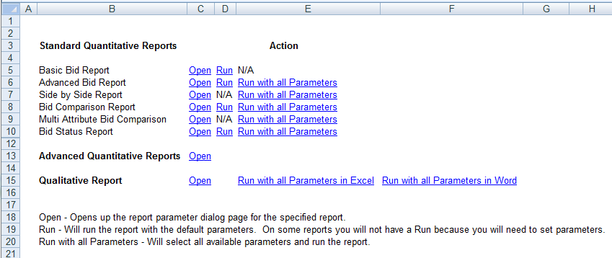
Demonstration and Ad Hoc Exercise: Sourcing Desktop Intelligence, cont.
The file creation job will complete in Data Manager, but may take awhile because concurrent requests are apparently single-threaded (look for Pending state). On completion, save the file and open it in Excel. Ignore the ActiveX security warning, if any, and be sure to enable macros (watch for a warning).
Notice the two sheets in the file. The first, Export, contains the details about the RFx. The second sheet, Reporting Quick Launch, should look something like the following:

Slide 7
Demonstration and Ad Hoc Exercise: Sourcing Desktop Intelligence, cont.
Clicking Open beside a Standard report takes you to a new window for defining the parameters for that report. (In that new window you can also switch to a different report.) “Run” will run the report with the parameters you picked, while “Run with all Parameters” will do just that.
Click on “Open” beside Advanced Quantitative Reports. A new window, Run Criteria, will open with many tabs.
    On the Attributes & Suppliers tab, click “Select All” beneath each column to include all attributes/suppliers. Optionally hold down Ctrl and click to remove some of them.
    On the Item Statistics tab, choose two Bid Attributes, including Price Per Unit, and two Statistical Functions. There should now be four entries under Item Statistics (2x2).
    Similarly, specify at least one Statistic on each of the Bid Statistics and Ranking Statistics tabs.

Slide 8
Demonstration and Ad Hoc Exercise: Sourcing Desktop Intelligence, cont.
Advanced Quantitative Report generation, continued:
    On the Outliers tab, choose Price Per Unit, Percentage, .1, Lowest, and Both for Steps 1-5.
    Look at the User Defined, Currency, and Filters tabs, but don't enter anything.
    On the Reports tab:
        On all three of the tabs (e.g., Supplier Bid Report), check all of the “Include” boxes. When you do this, on the right, below “Sorting”, it will show how many columns and sheets that tab's report will have. Also, if you right click on “Include Item Attributes”, a display will show the attributes you chose.
        Click “Run Reports”. You should get a warning that you wanted User Defined information reported, but you didn't create a User Defined field. On each of the three report tabs, uncheck “Include User Defined”.
        On whichever report tab you're on, click “Format Report”.

Slide 9
Demonstration and Ad Hoc Exercise: Sourcing Desktop Intelligence, cont.
Advanced Quantitative Report generation, continued:
    After clicking “Format Report”, a new Excel file will open with the default formatting for the report you chose. Make a simple change such as to the fill color of the headings in row 1.
    The Report Criteria window should have been minimized to the bottom left when you clicked Format Report. Restore it, then click Run Reports.
    If an error is reported, correct it by going to the appropriate tab, then return to Reports and Run Reports again.
    The reports will be generated in real time (Data Manager is not involved). Each report will be in a separate multi-sheet file in Excel.
Each report will have a Table of Contents sheet (first) and Report Summary sheet (last). The latter is a very readable description of what has been generated.
Look at some of the other sheets, which contain the comparisons, etc. that you requested. The unique information on each sheet will be in the rightmost columns.

Slide 10

Questions?

